Slide 1

HyperSizer Version 5.8.11
New Features and Software Enhancements
Collier Research Corporation
Hampton, VA
© 2009 Collier Research Corp.

Slide 2
Summary of New Capabilities
Orthotropic Material Correction Factors
  Multiple general correction factors for both ply and laminate material properties
  Correction factors for stiffness and material allowables
  Correction factors as constant values or functions of:
    Temperature
    Laminate %0s, %45s
    Laminate AML (Angle Minus Longitudinal) Number
    Laminate Thickness
    Fastener Hole Diameter
  What-If Scenarios to visualize material data for any given laminate/temperature/thickness, etc.
  Graphical display of material data as functions of independent data (i.e. Temperature, %0s, %45s, etc.)

Slide 3
Summary of New Capabilities
Bolted Joint Stress-Field Method (BJSFM) Method
  Dedicated Bolted Joint Analysis Form
  All input and output data for BJSFM gathered in one place
Object Model based spreadsheets for data management
  Ability to enter sizing variables, materials and variable bounds through the Object Model

Slide 4
Summary of Enhancements
Backdoor Options
  Default Backdoor Options Set in Database
  Company Specific backdoor options included in Database Template
Improved Reporting on Failure Tab
  Ability to show margins for Controlling Load Set as well as minimum margin per failure mode
  Sorting and Hiding of inactive failure modes
Improvements to Effective Laminate Generation
New Failure Modes
  Eleven new laminate based strain failure methods
  Flexural/Torsional Buckling of Uniaxial Stiffeners
  “Scissor” Mode Buckling of Hat Stiffened Panels
Additional Enhancements / Bug Fixes

Slide 5
Orthotropic Material
Correction Factors

Slide 6
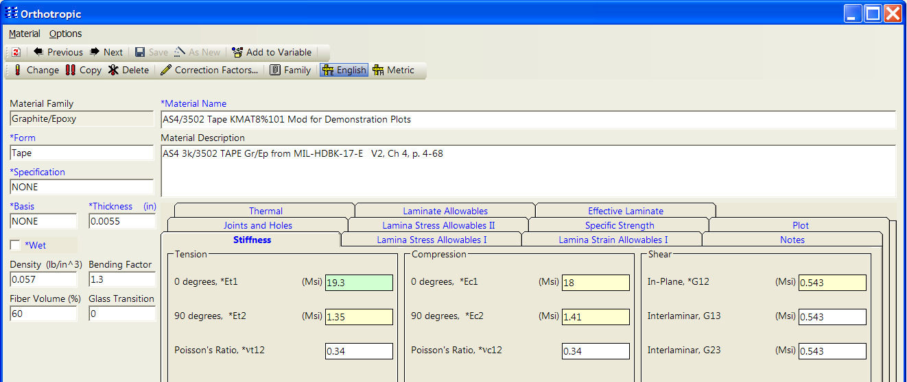
Composite Material Correction Factors
Properties on the orthotropic material form is highlighted to indicate which properties have correction factors applied and which properties have correction factors available.
Properties that have corrections applied are highlighted Green
Properties that have correction factors available, but none are currently applied are highlighted yellow
Properties that do not have correction factors available are white

Slide 7
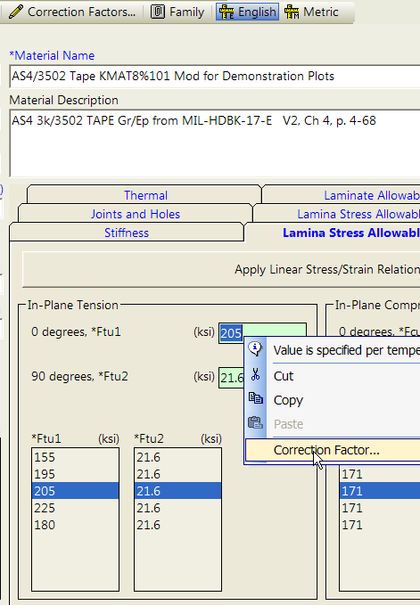
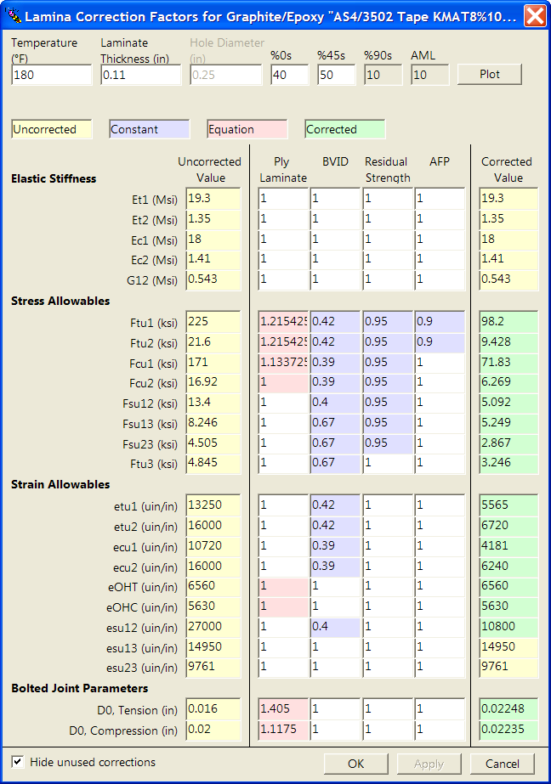
Composite Material Correction Factors
After entering material data, right click on the property and select Correction Factor… or press the button at the top of the form

Slide 8
Composite Material Correction Factors
User enters values for temperature, thickness, %plies, etc. and form automatically updates:
uncorrected properties
corrected properties
Correction Factors can be either:
constant values (shown in blue)
equations (shown in pink)
User can enter any combination of constant or equation based corrections and HyperSizer will automatically combine them to find the final material property

Slide 9
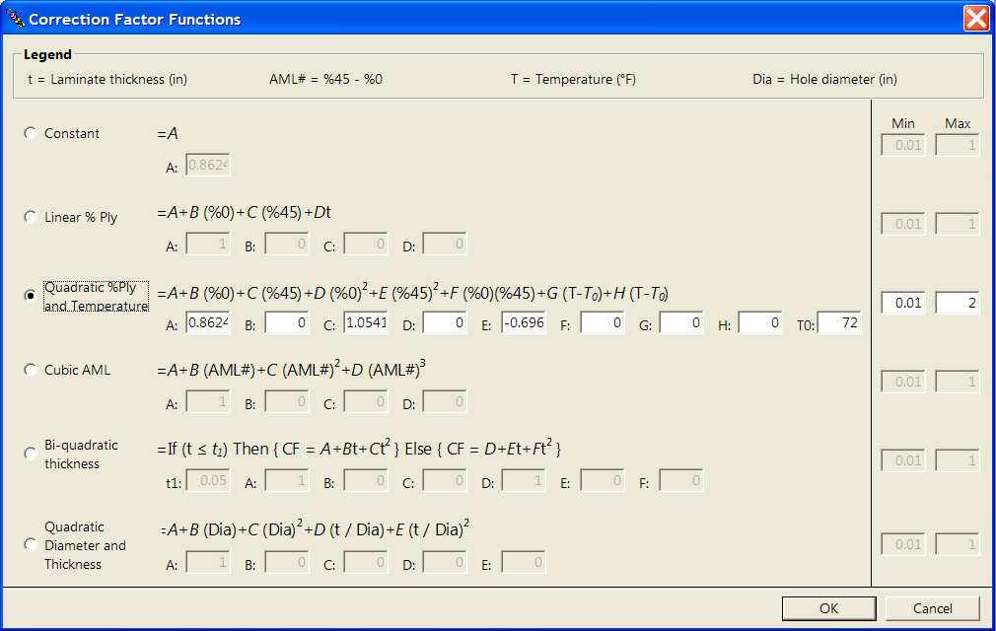
Composite Material Correction Factors
All correction factors can be entered as a function of:
  Temperature
  %0, %45, AML
  Thickness
  Hole Diameter
Double clicking a function based correction will raise the Correction Factor Functions form
Cut-off values provided to ensure that correction factors do not go out of bounds

Slide 10
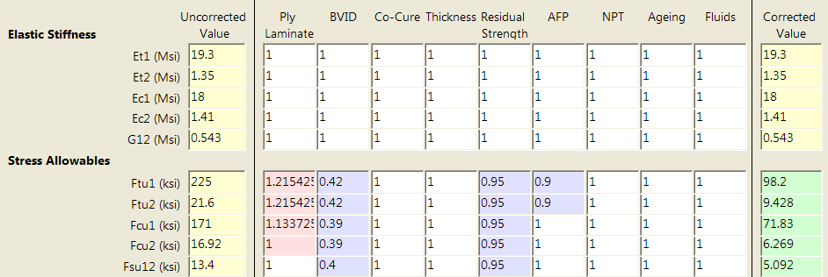

Composite Material Correction Factors
HyperSizer provides many different correction factors. Unused factors can be hidden using the “Hide Unused Corrections” checkbox

Slide 11
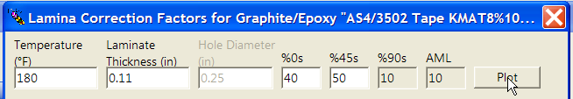
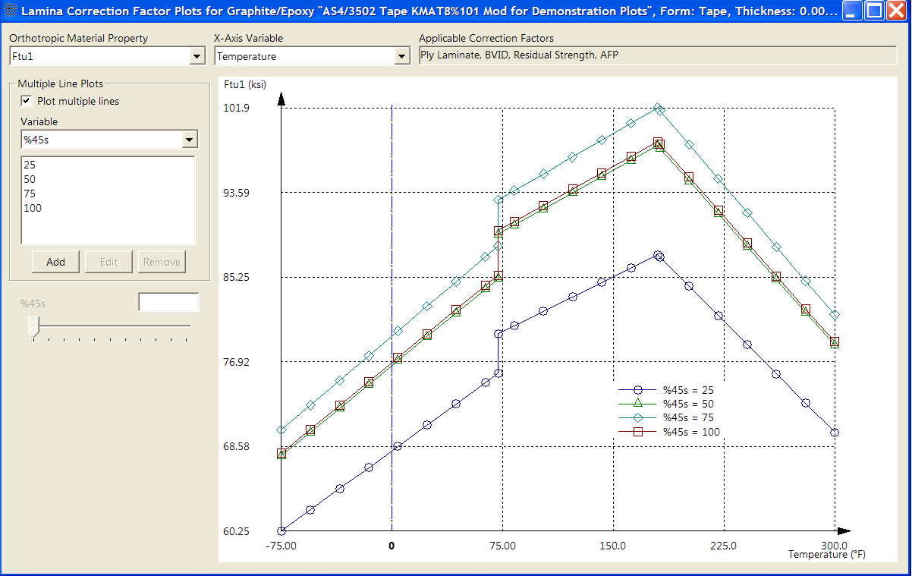
Composite Material Correction Factors
Interactive Plots help the user visualize the effect of correction factors
All properties
Multiple independent variables
User chooses property to plot
Displays correction factors used by this property
User can specify multiple points for a second independent variable

Slide 12
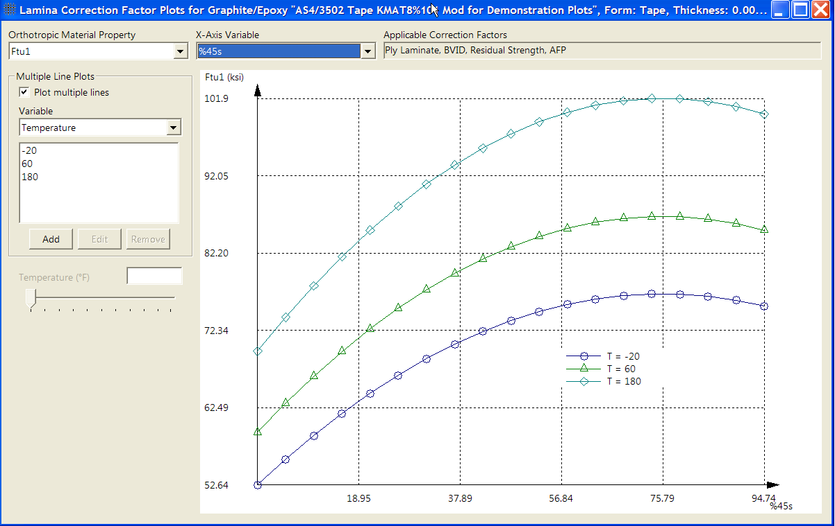
Composite Material Correction Factors
Data can be viewed as a function of any independent variable
(e.g. temperature or %45)
User chooses independent (x) axis variable
User can specify multiple points for a second independent variable

Slide 13



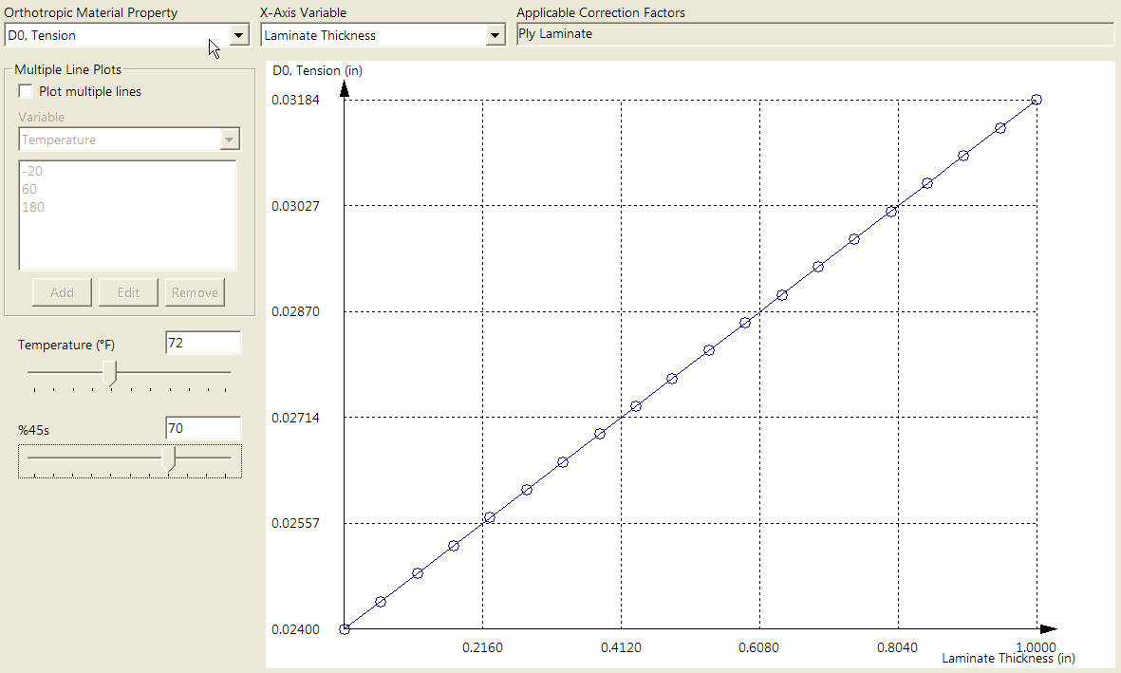
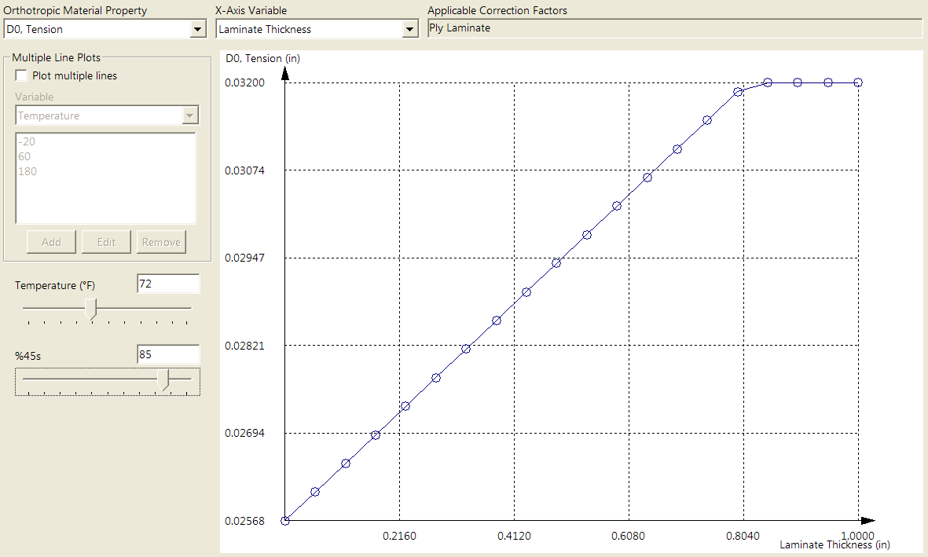
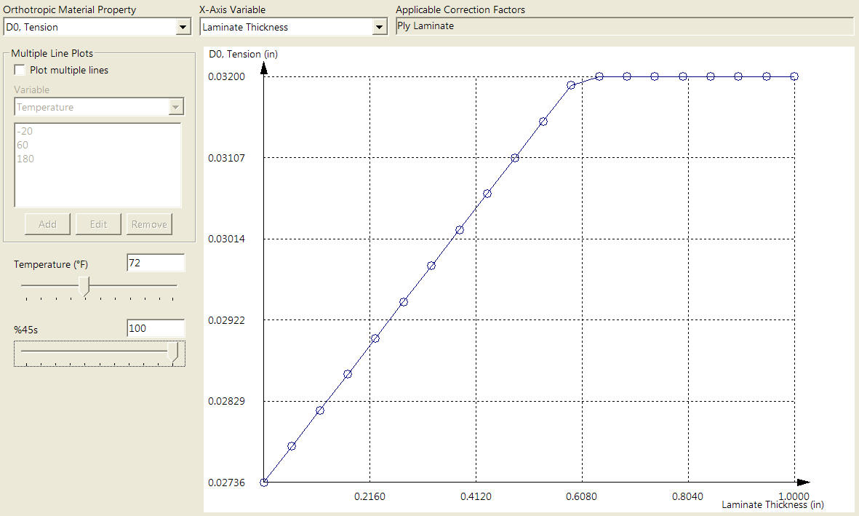
Composite Material Correction Factors
User can interactively change plots by changing the slider bars
For properties that are functions of multiple independent variables, one variable will be used as the “X” axis and the other variables will have slider bars

Slide 14
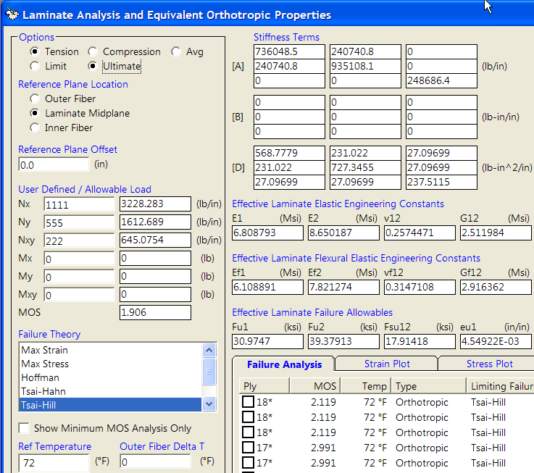
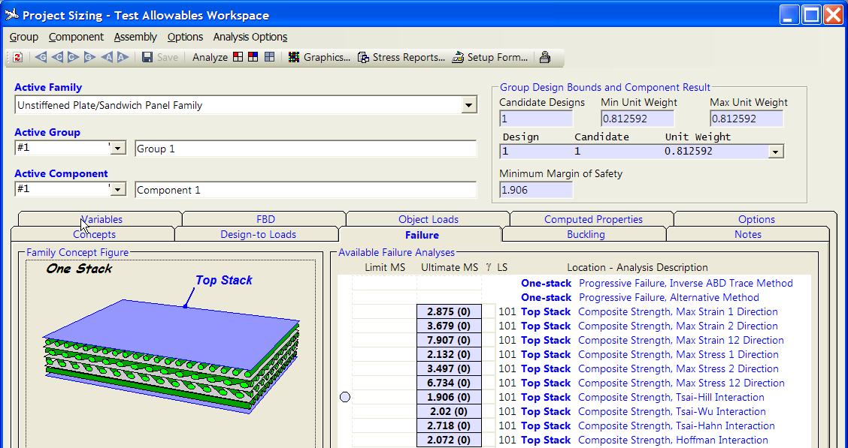
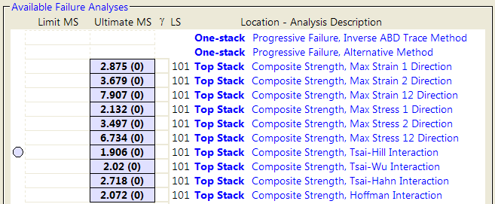
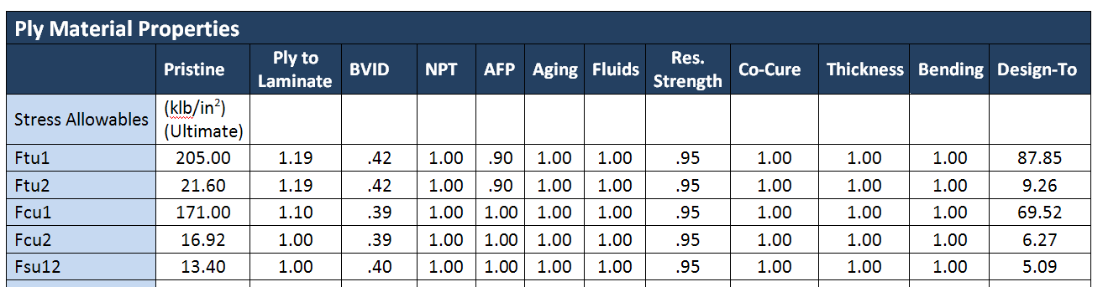
New Composite Design Methodology
Correction Factors reflected in all HyperSizer Calculations
Laminate Analysis Form
Sizing Form Analysis
Stress Reports

Slide 15
BJSFM Enhancements

Slide 16

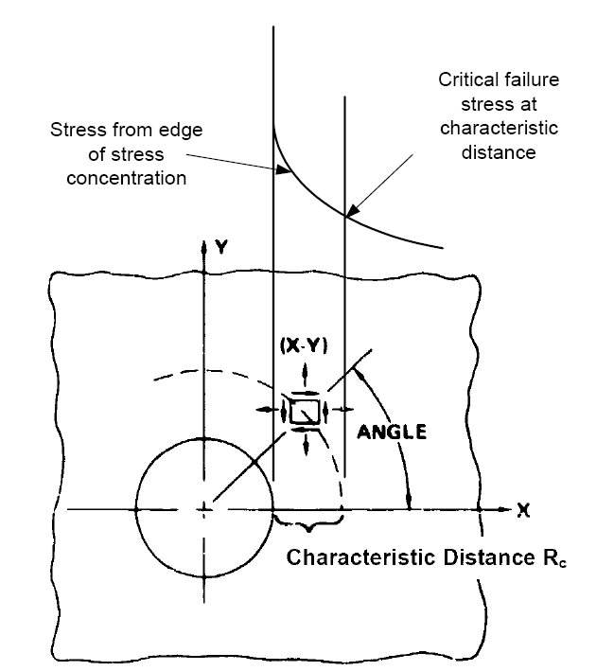
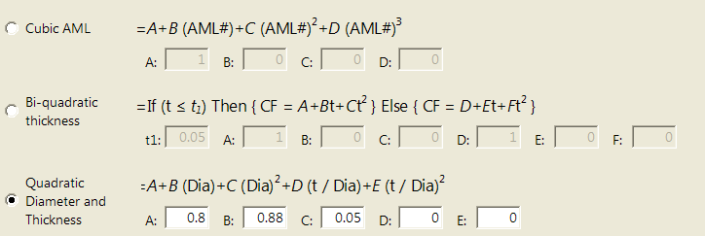
BJSFM Enhancements in Version 5.8
BJSFM – Characteristic Distance
BJSFM V5.8 Includes a tension and compression characteristic distance
  Tension D_{o}
  Compression D_{o}
  Do is material dependent (Lowest Do is used Hybrid analysis)
D_{o} can be dependent on thickness, diameter,
%45 deg, %0 deg plies or AML
  Hypersizer includes correction equations for D_{o}
Orthotropic Form – Joints and Holes
Orthotropic Form – Correction Factors

Slide 17
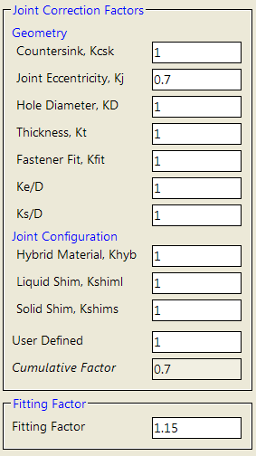
BJSFM Enhancements in Version 5.8
BJSFM V5.8 – New Test Correction Factors
BJSFM Includes TEST correction factors
  Test correction factors are COMPONENT based
BJSFM test correction factors list (Industry Standard)
  K_{csk} - Fastener head countersunk correction
  K_{J} - Joint Eccentricity correction
  K_{D} - Hole diameter correction
  K_{t} - Thickness correction
  K_{fit} - Hybrid correction
  K_{e/D} - Edge distance correction
  K_{s/D} - Side distance correction
  K_{hyb} – Hybrid correction
  K_{shiml} - Liquid shim correction
  K_{shims} – Solid shim correction
  K_{user} – User defined correction
Hypersizer Default – All corrections = 1.0
Fitting Factor Default = 1.15

Slide 18
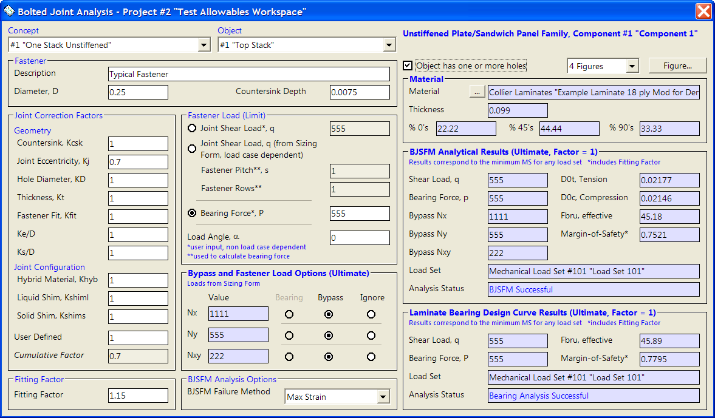

BJSFM Enhancements in Version 5.8
Hypersizer V5.8 – BJSFM Detailed Analysis
New BJSFM Detailed Analysis Form
Form also includes classic P/A bearing analysis with correction factors
1
1

Slide 19
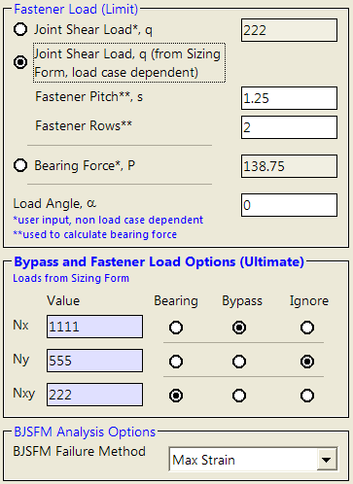
BJSFM Enhancements in Version 5.8
BJSFM Loads Input
Fastener load input – Three available methods
  Enter joint shear flow (User enters pitch and no of fastener rows)
  Use multiple load set Nxy from sizing form (User enters pitch and no of rows)
  Enter unfactored fastener load and angle
1
2
3
1
2
Fastener pitch and number of rows is required for load option 1 and 2
3
Option to include or exclude hole bypass loads
Fully Automated
Component Free-Body loads used to calculate fastener load in option 2
2

Slide 20
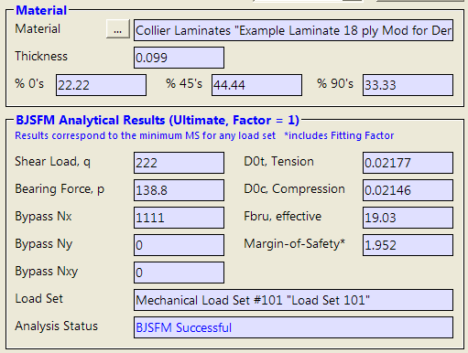
BJSFM Enhancements in Version 5.8
BJSFM Output
The output is shown in two locations
  1) BJSFM Detail analysis Form
  2) Hypersizer Stress Report
1
Laminate Configuration
1
Analysis characteristic distance
Applied loads including ultimate factor
Effective bearing Stress
BJSFM Message provided for error messages and user feedback
Critical Load condition

Slide 21
BJSFM Enhancements in Version 5.8
BJSFM Future Enhancements (2010)
Test Correction Factors
  BJSFM Test Correction Factors will be stored as equations
  BJSFM Correction factors calculated by Hypersizer using the input parameters such as hole diameter, thickness, %45 plies etc
BJSFM Fastener Database
  Fastener database will include customer preferred fasteners
  Database parameters:
    Fastener Type (Csk etc)
    Fastener Material
    Diameter
    Countersink depth
    Head dimensions (Could be used for pull thru analysis)
    Weight
    Allowable shear (Include NEW fastener analysis)
    Allowable tension
Automated Multiple Load Conditions
  Hypersizer V5.8 automates application of bypass loads for multiple load cases
  Future BJSFM will automate bolt load calculation

Slide 22
Object Model Based
Data Management
Spreadsheets

Slide 23
Data Management Spreadsheets
Spreadsheets that use the HyperSizer Object model have been developed that allow the user to:
  Extract Assembly, Group, Component results
  Set Component Properties
  Most HyperSizer Data Quantities are available including:
    Sizing Variables
    Loads
    Materials
    BJSFM Input/Output
    Sizing Results
    Other (e.g. Xspan, Yspan, etc.)
Source code behind spreadsheets is open and fully commented for easy customization
Data Management Spreadsheet available at:
  http://hypersizer.com/software-downloads.html

Slide 24
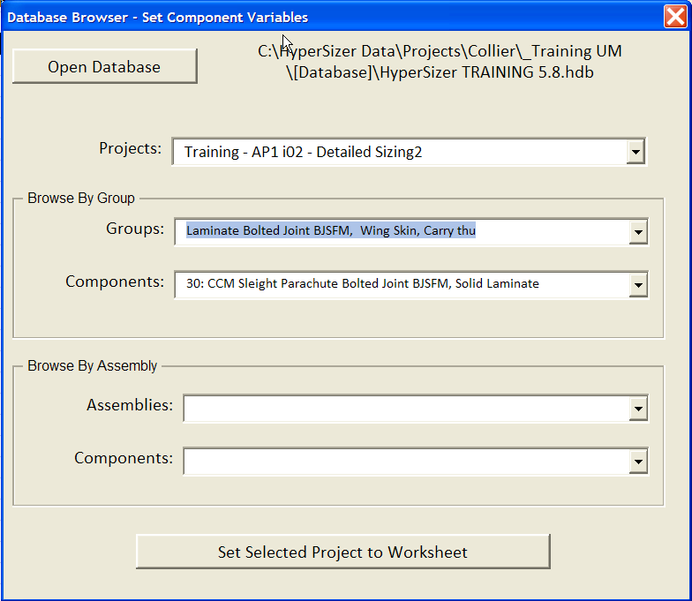
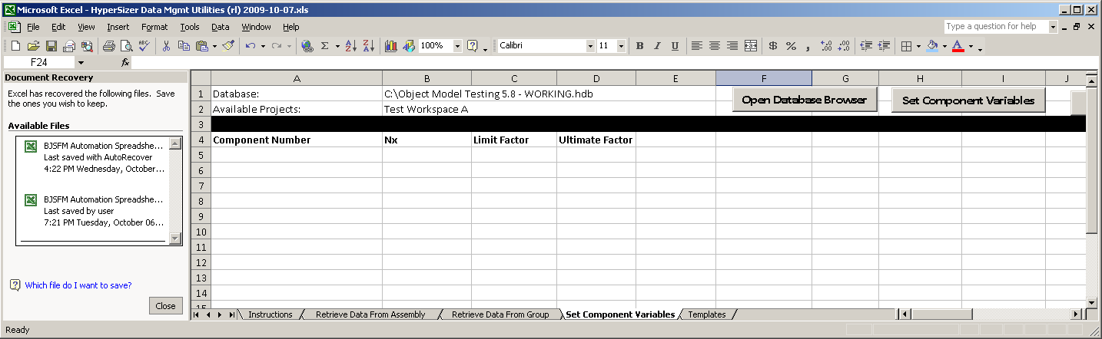
Data Management Spreadsheets
Spreadsheet for Setting Component Variables
Select a Database , Project, Group, and Component
Specify component numbers and select component variables to set (for example, Nx, Limit Load Factor, Ultimage Load Factor)
Use the browser to find the desired database and project, then select “Set Selected Project to Worksheet”
Notice the active database and project are listed in the upper section of the workbook for reference

Slide 25
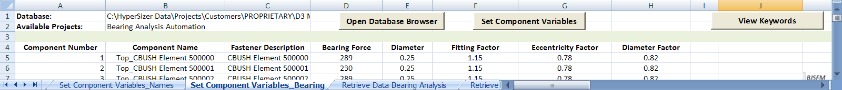
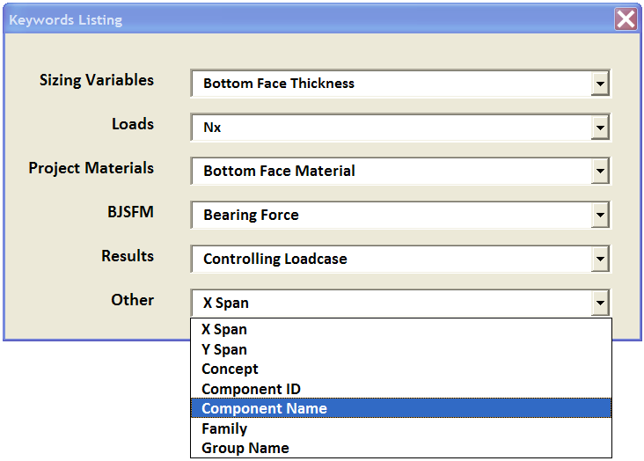
Data Management Spreadsheets
Press the View Keywords button to retreive the list of available data entities for column headings
The spreadsheet dynamically detects which data to place in each column based on keywords
To add a Keyword, browse the Keyword Listing Form
Copy the desired Keyword to the workbook in row A
General rules of thumb when working with Object model spreadsheet:
Use Separate workbooks for separate databases
Always list component number first
Don’t leave gaps in Keyword Column A, HyperSizer will skip all vacant cells

Slide 26
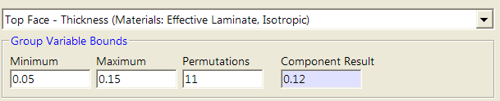
Setting Group Variable Bounds
New in HyperSizer Version 5.8 is the ability to set individual Variable Bounds and Materials such as facesheet thickness min, max, number of permutations, and material
With a Group Object, set the min, max and permutations such as:
  oGroup.VariableBound(vpdTopFace_ThicknessMaterial, vbdMinimumBound) = 0.05
  oGroup.VariableBound(vpdTopFace_ThicknessMaterial, vbdMaximumBound) = 0.15
  oGroup.VariableBound(vpdTopFace_ThicknessMaterial, vbdPermutations) = 11
  oGroup.Save
  oGroup.Size
  Msgbox oComponent.ResultVariable(vpdTopFace_ThicknessMaterial,1)

Slide 27
Improved
Management of
“Backdoor” data

Slide 28
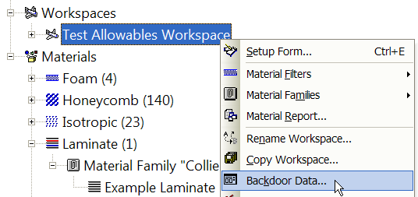
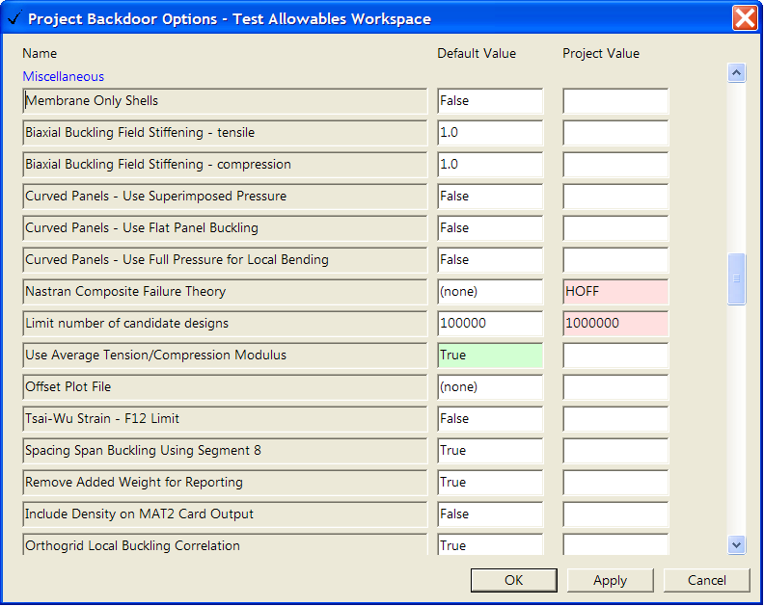
Backdoor Data in Version 5.8
Default and Project Based Backdoor Data can now be entered through the Database Explorer Tree
Support for the ASCII based, “HyperSizer.HBD” file has been discontinued (default values now entered through database)
HyperSizer Default Values
(white background)
This value will be used only no user default or project value entered
Blank Field – No Project Value,
use default
Preferences for backdoor data:
Use project value
If no project value, use user default value
If no user default value, use HyperSizer default value
User Entered Default Values
(green background)
This value will be used for all projects/workspaces in the current database
Project Values
This value will be used for this project or workspace only

Slide 29

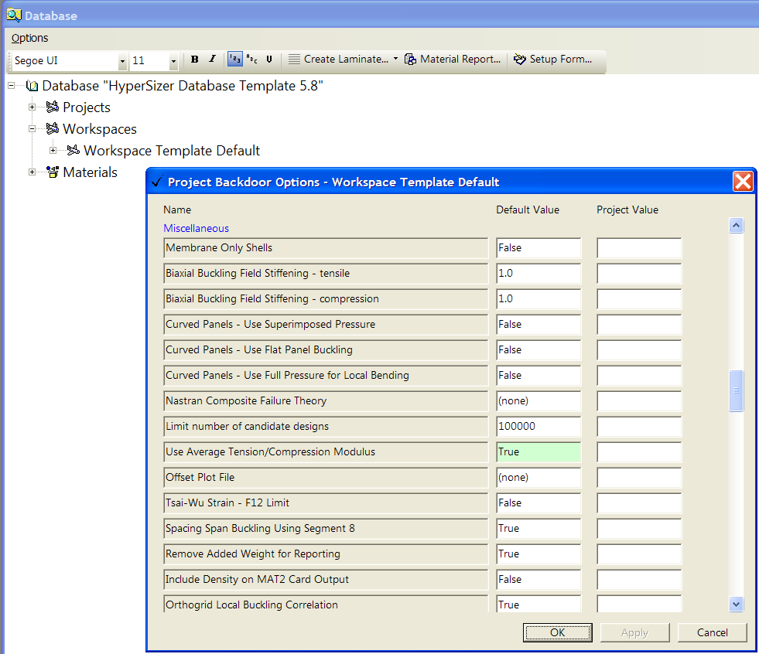
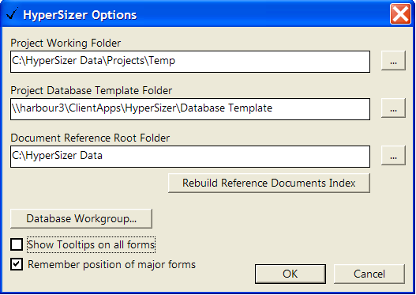
Backdoor Data in Version 5.8
Backdoor data defaults should be entered into the HyperSizer Template database so that all created databases will have the same defaults
Preferences for backdoor data:
Use project value
If no project value, use user default value
If no user default value, use HyperSizer default value

Slide 30
Version 5.6.38
Enhancements

Slide 31
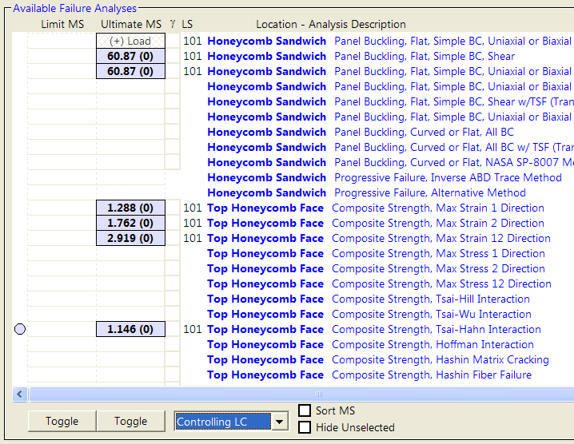
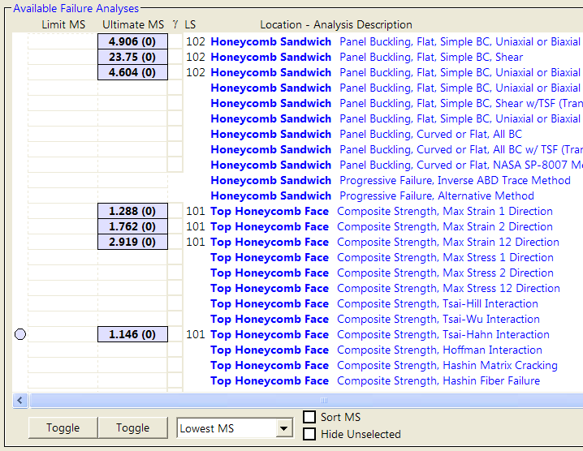
Improved Reporting on Failure Tab
Failure Tab can now display either:
  Margins of Safety for Controlling Load Set
  Lowest Margins of Safety for ANY Load Set
Margins of Safety for Controlling Load Set (HyperSizer Default)
Lowest Margins of Safety for ANY Load Set
All failure modes report margins for the controlling load set (101)
Buckling Modes have their lowest margins for Load Set 102
Tsai-Hahn returns the lowest margin, therefore its Load Set is controlling
Composite Failure Modes have their lowest margins for Load Set 101
In past HyperSizer Versions, the Failure tab always showed margins of safety for the controlling load set only, meaning that the lowest margin for each individual failure mode could not be seen.

Slide 32
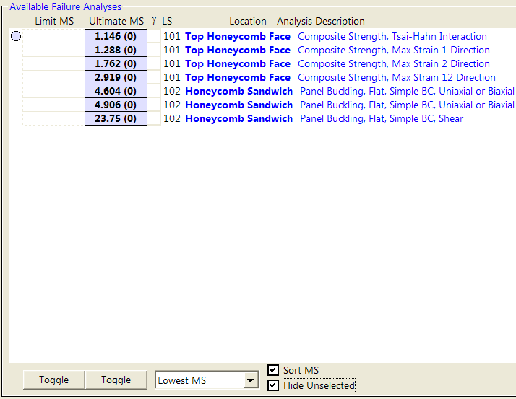
Improved Reporting on Failure Tab
Inactive Failure modes can now be hidden to make the failure tab easier to read
Margins sorted by Failure Mode
Failure Modes sorted by increasing margin of safety
Active and Inactive Failure Modes Shown
Inactive Failure Modes have been Hidden

Slide 33
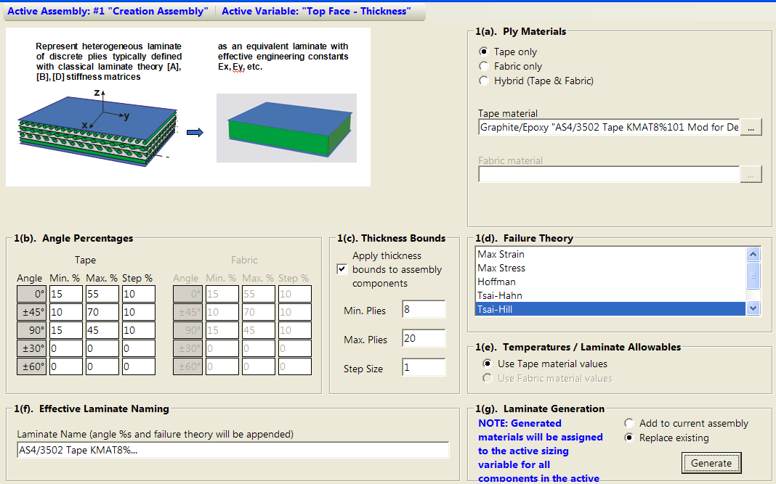
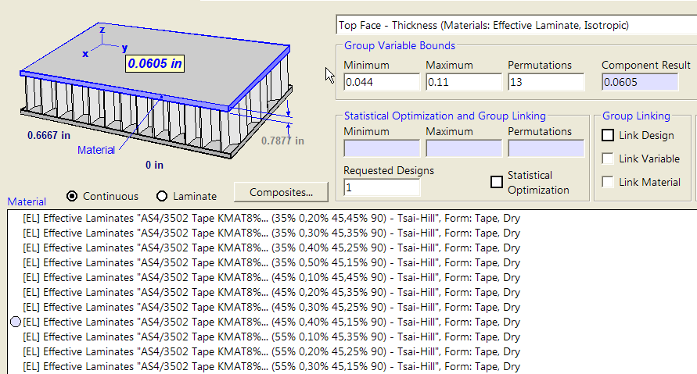
Improvement to Creation of Effective Laminates
When creating effective laminates, the user can now specify a min and max number of plies and this information is used to calculate min and max bounds for the sizing form.
8 plies = 0.044”
20 plies = 0.11”

Slide 34
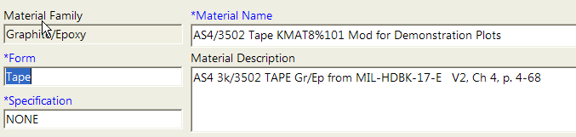
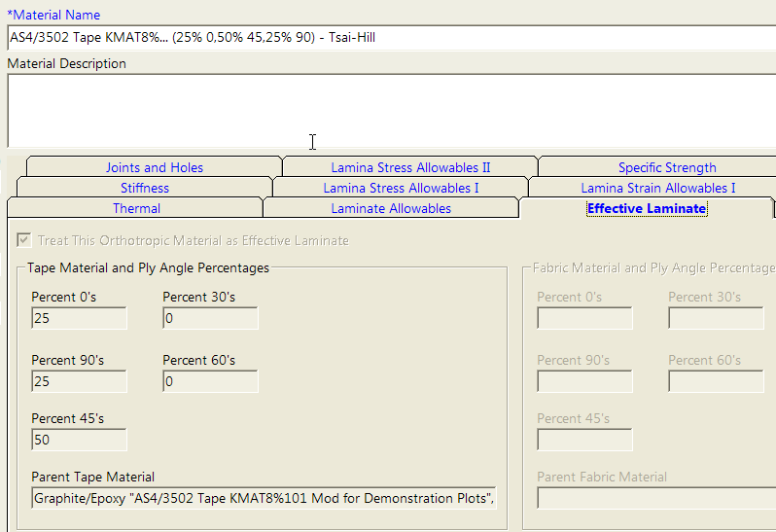
Improvement to Creation of Effective Laminates
If an Orthotropic Ply material is used to create an Effective Laminate,
then that effective laminate becomes linked to the orthotropic ply.
If the ply material is later changed by the user,
all effective laminates linked to the ply material will be updated.
AS4/3502 Tape Material is used to create Effective Laminate
AS4/3502 (25/50/25)
Ply Material becomes linked to effective laminate… any time ply changes, effective laminate is updated

Slide 35
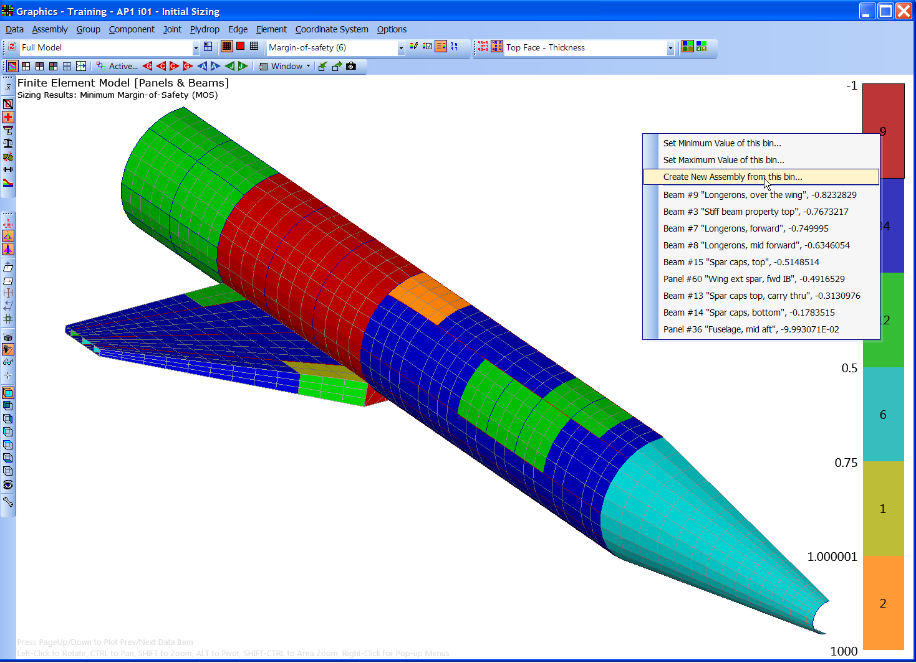
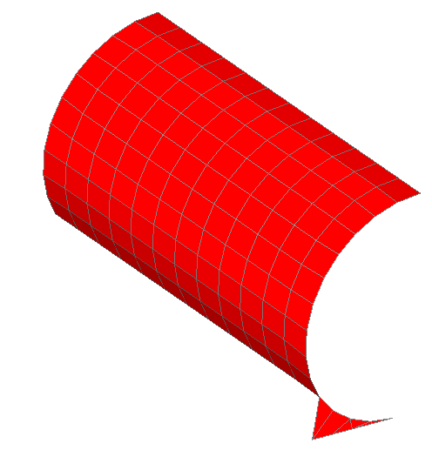
Improved Flexibility on the Graphics Form
User can select any data bin from the legend and create a new assembly from the members of that data bin.
Shown here are margins of safety for the Ap1 Training Example. Nine components have negative margins.
A new assembly can now easily be made from these components

Slide 36
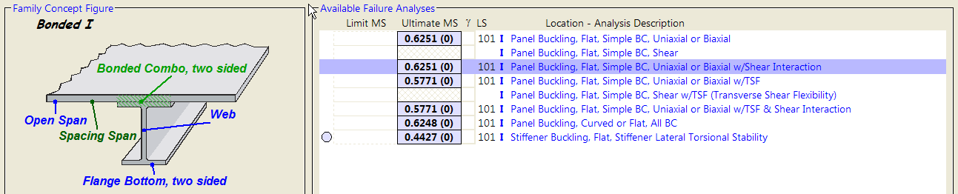
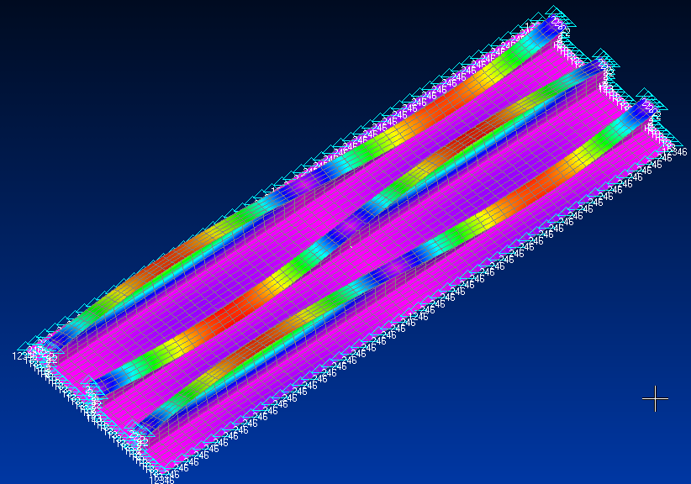
New Failure Modes
Flexural/Torsional Buckling of Uniaxial Stiffened Panels
In previous version of the software, the flexural-torsional buckling of a uniaxial panel (e.g. I, Z, T, etc) would not be calculated by HyperSizer which could lead to sizing of very tall thin stiffeners.
HyperSizer now checks for this very complex failure mode.

Slide 37
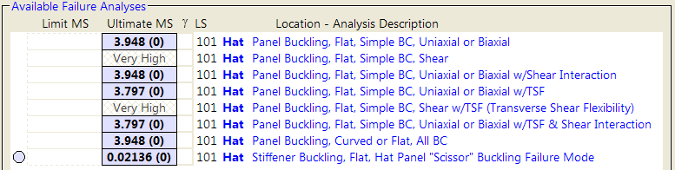
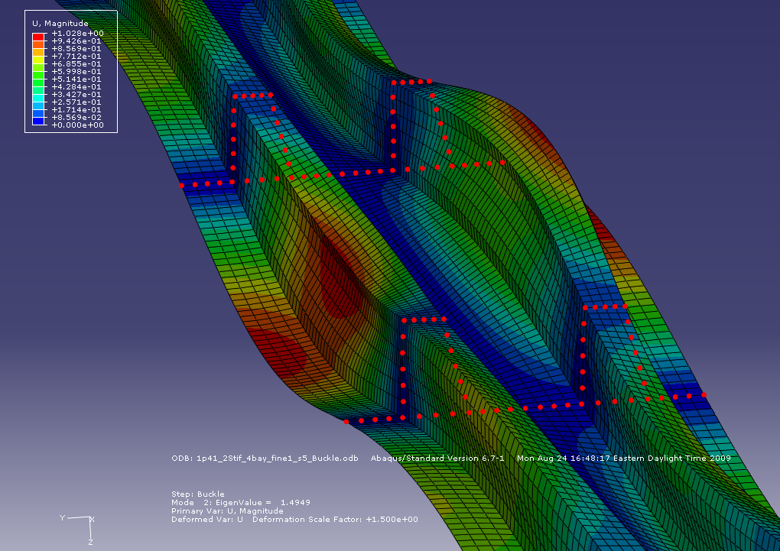
New Failure Modes
“Scissor-Mode” Buckling of Hat Stiffened Panels in biaxial compression
An observed buckling mode for hat stiffened panels has adjacent stiffeners alternatively deflecting up and down. We have called this a scissor buckling mode.
Margin of Safety Shown in HyperSizer
Verification of Scissor-Mode Buckling shown in ABAQUS

Slide 38
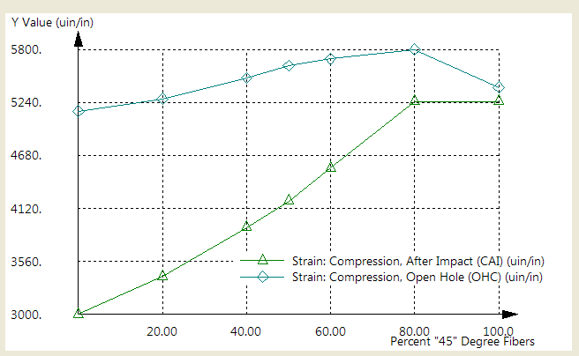
New Failure Modes
Eleven new Laminate Based Strain Failure Criteria
  Compression, Pristine
  Compression, After Impact (CAI)
  Compression, Open Hole (OHC)
  Compression, Filled Hole (FHC)
  Compression, Barely Visible Damage (BVID)
  Tension, Pristine
  Tension, After Impact (TAI)
  Tension, Open Hole (OHT)
  Tension, Filled Hole (FHT)
  Shear, Pristine
  Shear, After Impact (SAI)
  Strain allowables are entered as functions of %0, %45, and/or AML Number
  HyperSizer checks analytical strains in each primary analysis direction (-45, 0, +45, 90) against the above strain allowables
  Laminate Analyses are fully integrated with composite correction factors discussed earlier

Slide 39
Additional Enhancements / Bug Fixes
Fixed unit conversion problem from Version 5.7 where sandwich and unstiffened panel offsets were incorrectly written to the properties and material (*.PM1) file for Metric Units
List of recently opened databases is now listed under the File Menu of the HyperSizer Form
If user deletes all laminates or layups from database, can now create new laminates without application error.

